Slide 1
Eddy fluxes

Slide 2
What is an eddy?
U = <U> + U’, T = <T> + T’
<UT> = <U><T> + <U’T’>
<> denotes a monthly mean.
So an eddy is anything that varies faster than a month.

Slide 3
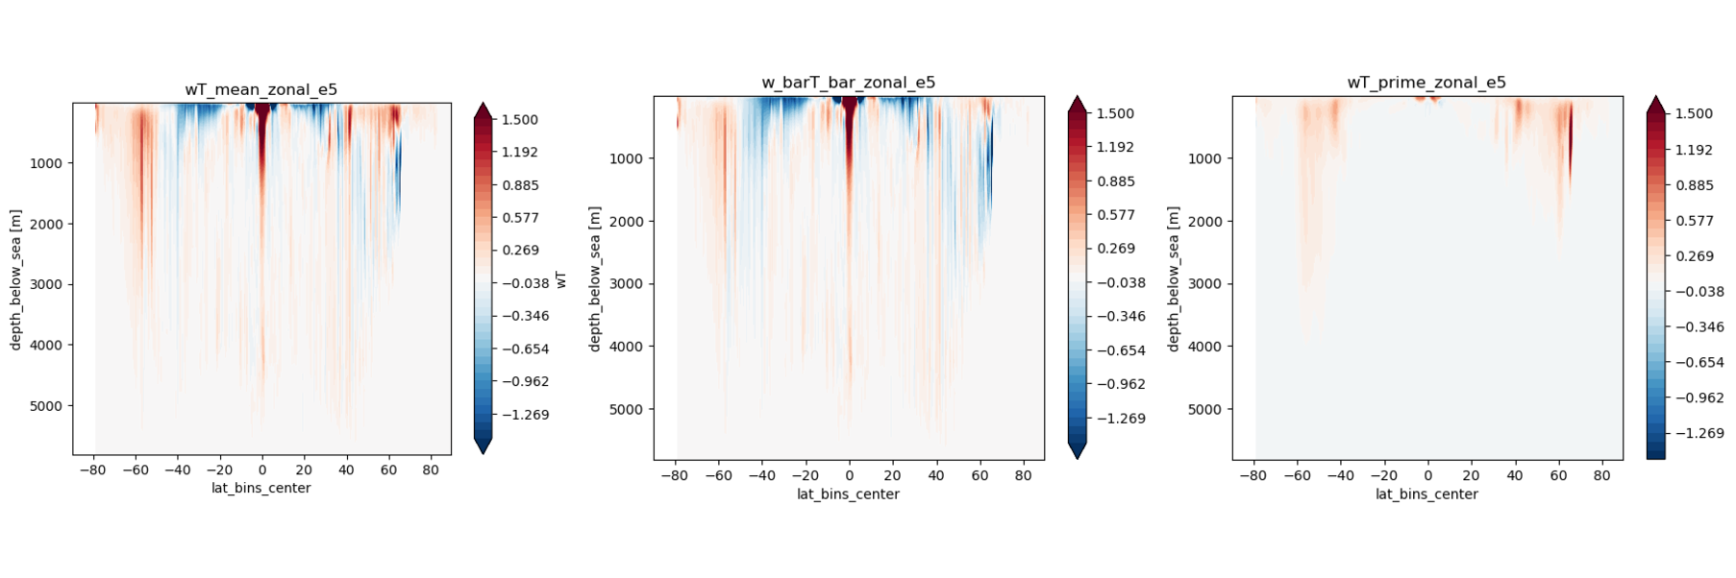
Vertical fluxes of heat in ICON EERIE
Notes:
Vertical fluxes of heat from ICON-EERIE run, 10 year temporal mean, zonal mean. Made by Jürgen.
Vertical eddy heat fluxes are big at the equator and in the high latitudes, especially northern hemisphere.
Jürgen, Andrea.

Slide 4
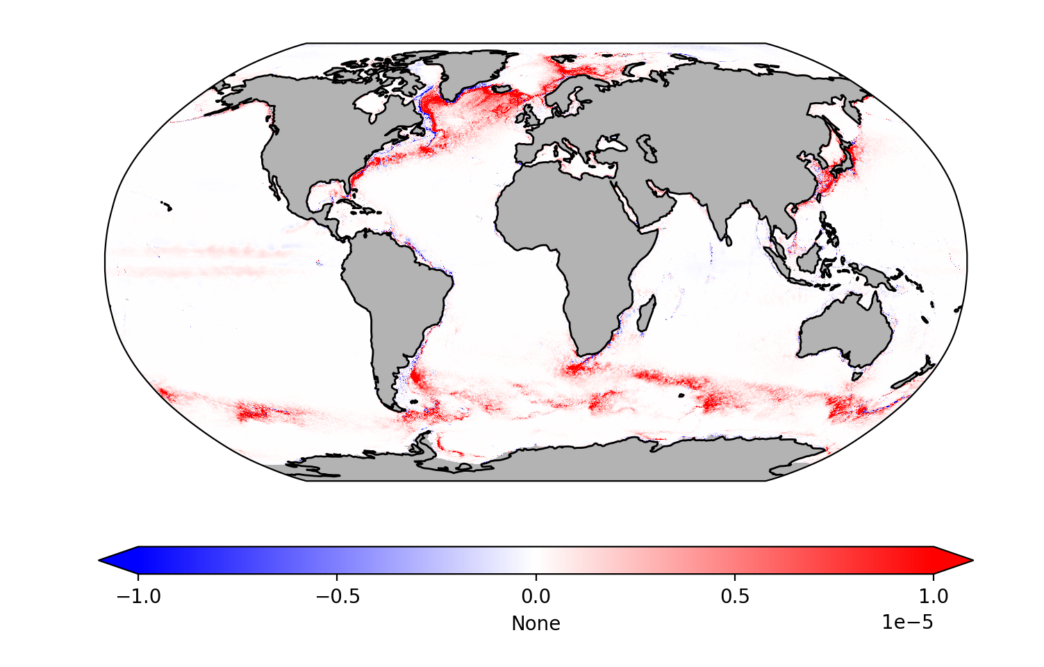
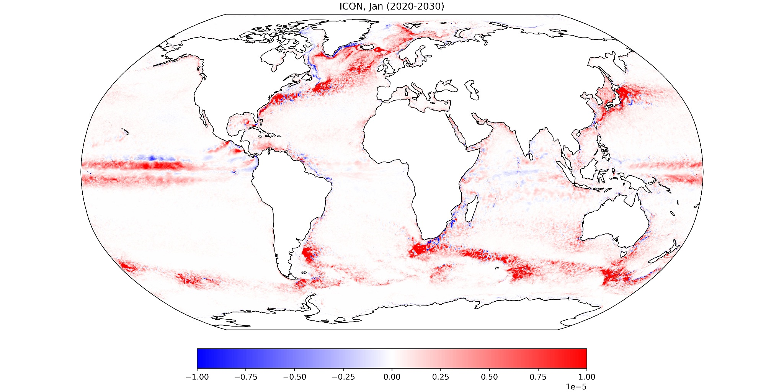
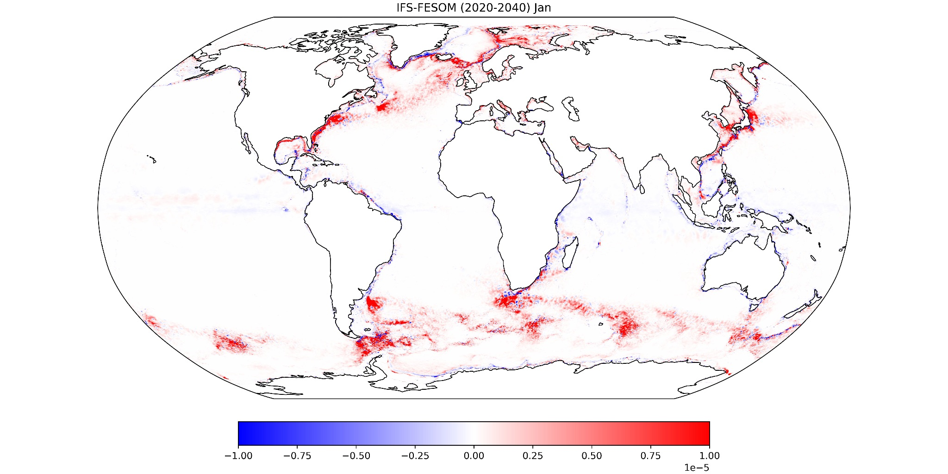
Column mean vertical fluxes of heat, January climatology, x10^-5 K m / s
ICON, Ngc4008,
10 yrs
Fesom,
NextGems,
20 yrs
ICON, EERIE,
30 yrs
Notes:
Column mean, vertical eddy heat flux, 30 year January climatology. ICON-EERIE, IFS-FESOM, ICON-NGC4008
Equatorial stuff starts to fade with averaging.
Labrador Sea?!?
Fraser, Boris, Ingo

Slide 5
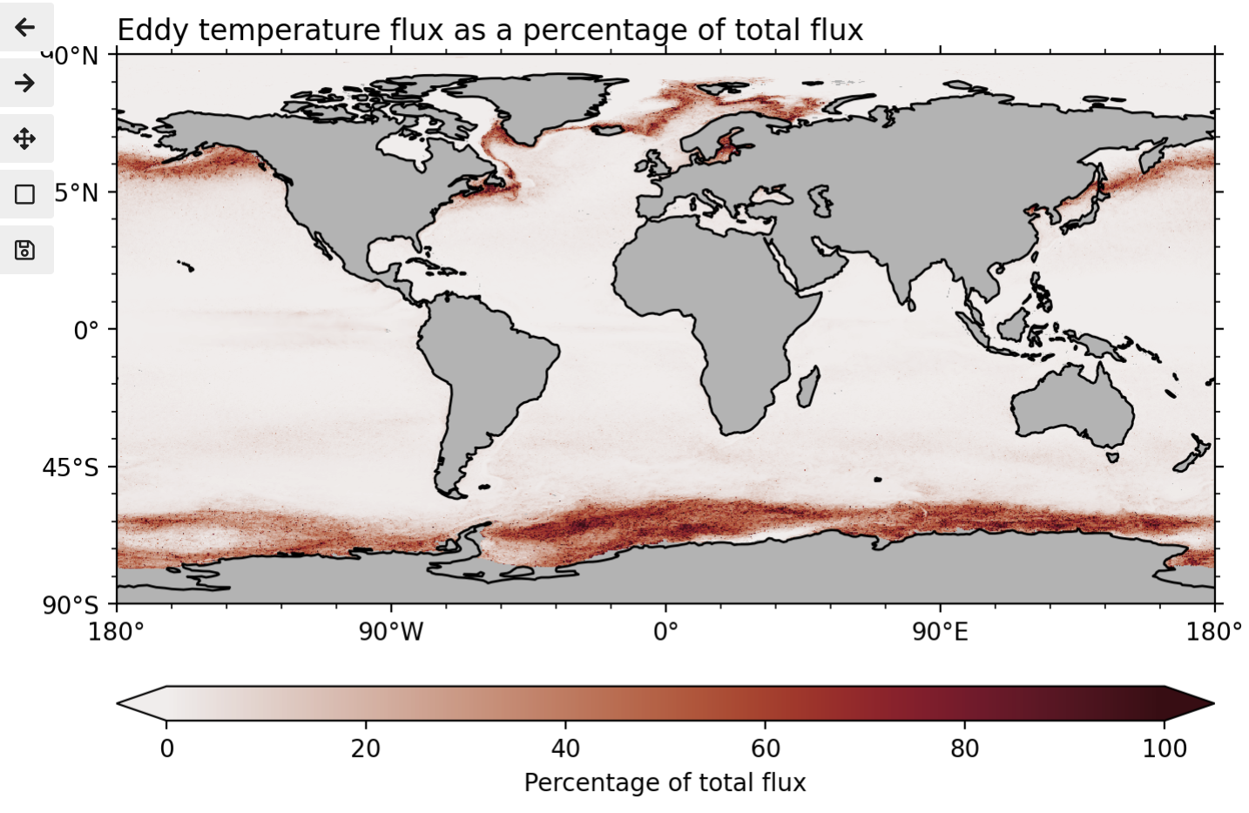
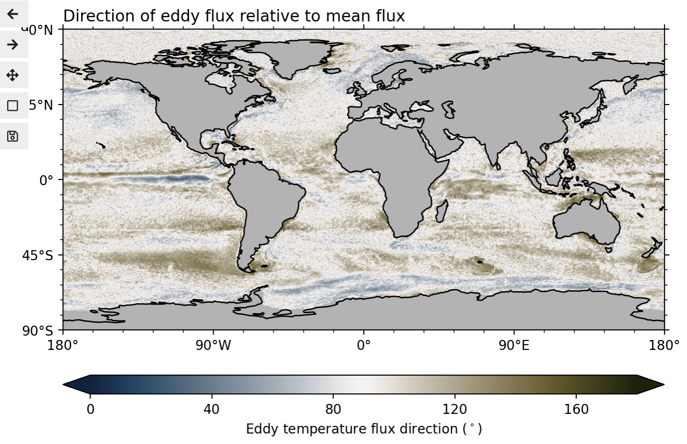
Horizontal eddy fluxes relative to the total flux
Same direction
At right angles
Opposite direction
Notes:
Horizontal eddy temperature fluxes, surface level, January climatology, ICON-EERIE model.
Unsurprisingly, eddies are important in Southern Ocean and boundary current regions.
Fraser

Slide 6
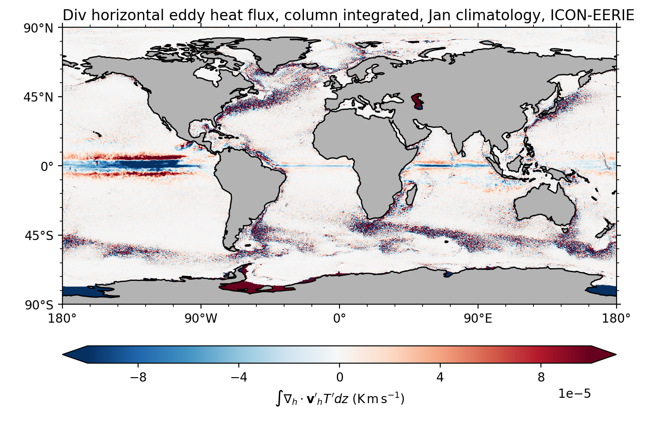
More structure when looking at individual levels
Way more structure than instantaneous fields.
Strong structure in the Tropics
Some structure around boundary currents (divergent in current core, convergent at edges.)
Notes:
Eddies really heat the Equatorial Pacific.
Tend to have positive in boundary current cores, negative just outside.
Fraser, Emma

Slide 7
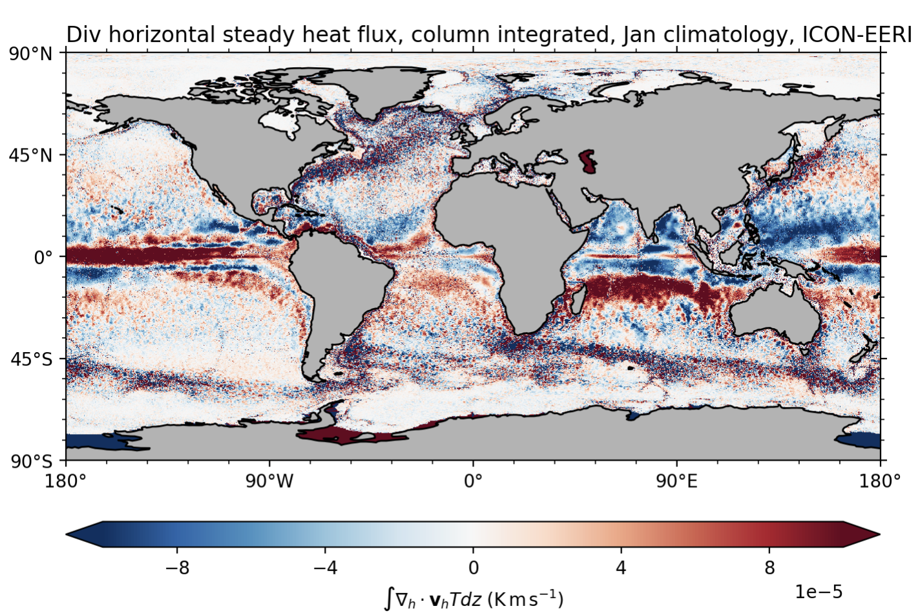
Notes:
Eddies really heat the Equatorial Pacific.
Tend to have positive in boundary current cores, negative just outside.
Fraser, Emma

Slide 8
More structure when looking at individual levels
Way more structure than instantaneous fields.
Strong structure in the Tropics
Some structure around boundary currents (divergent in current core, convergent at edges.)
Notes:
Eddies really heat the Equatorial Pacific.
Tend to have positive in boundary current cores, negative just outside.
Fraser, Emma

Slide 9
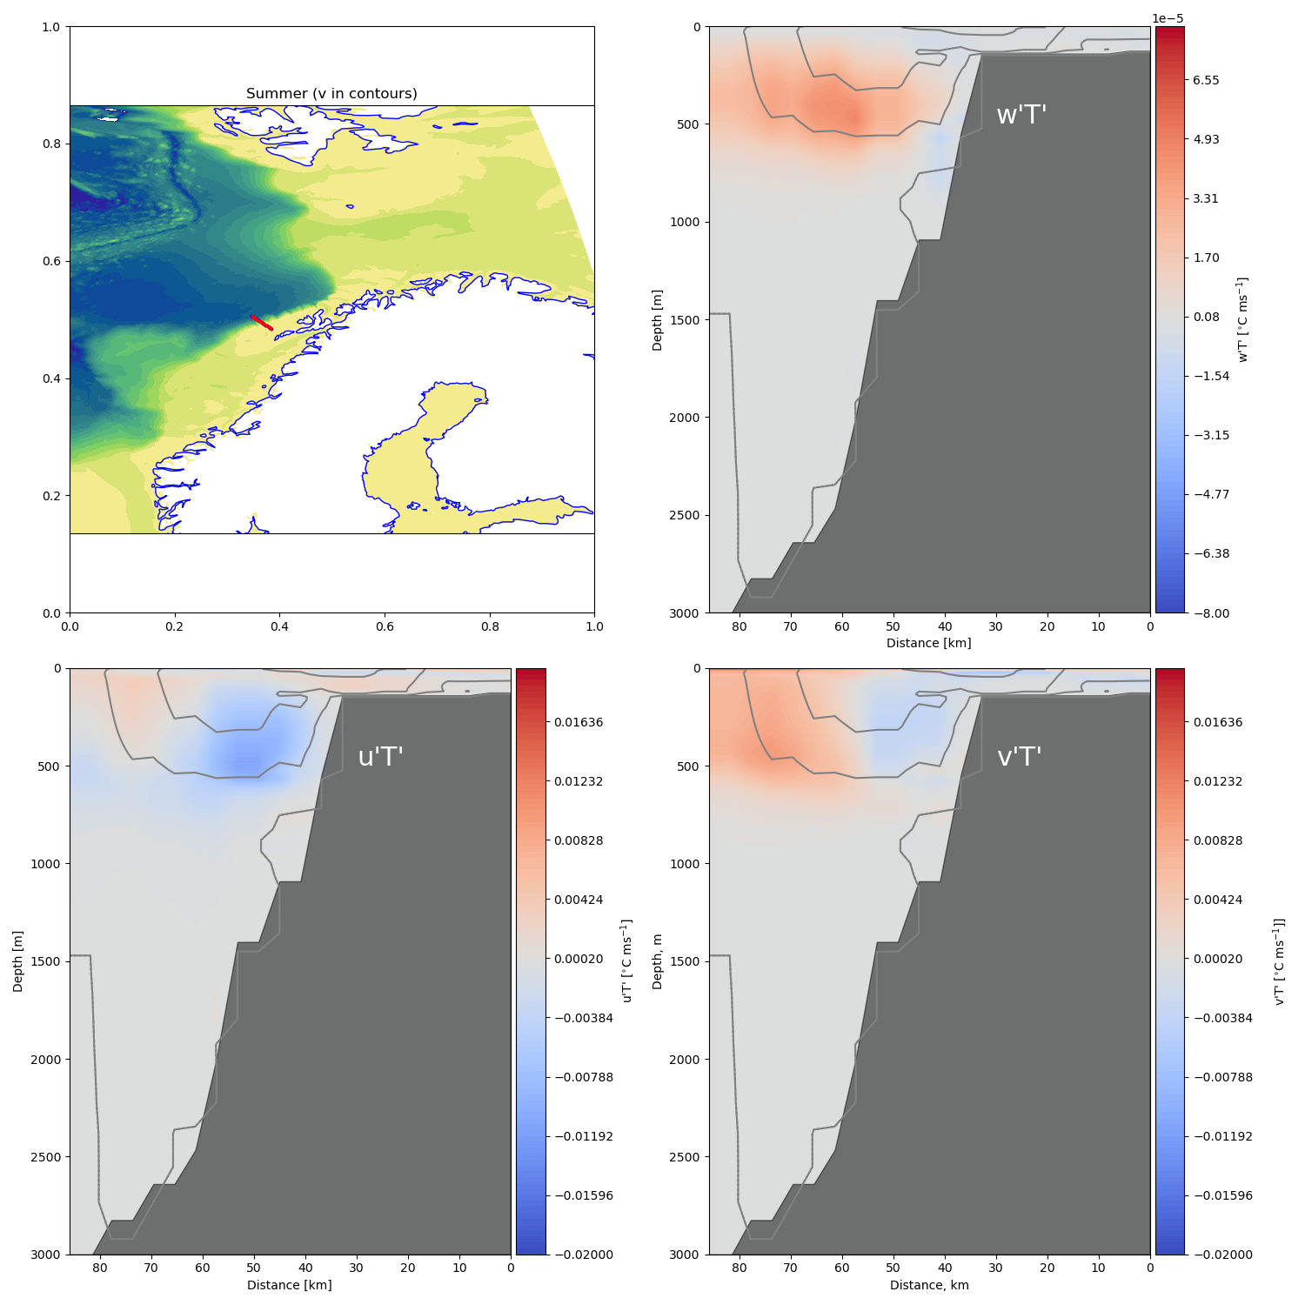
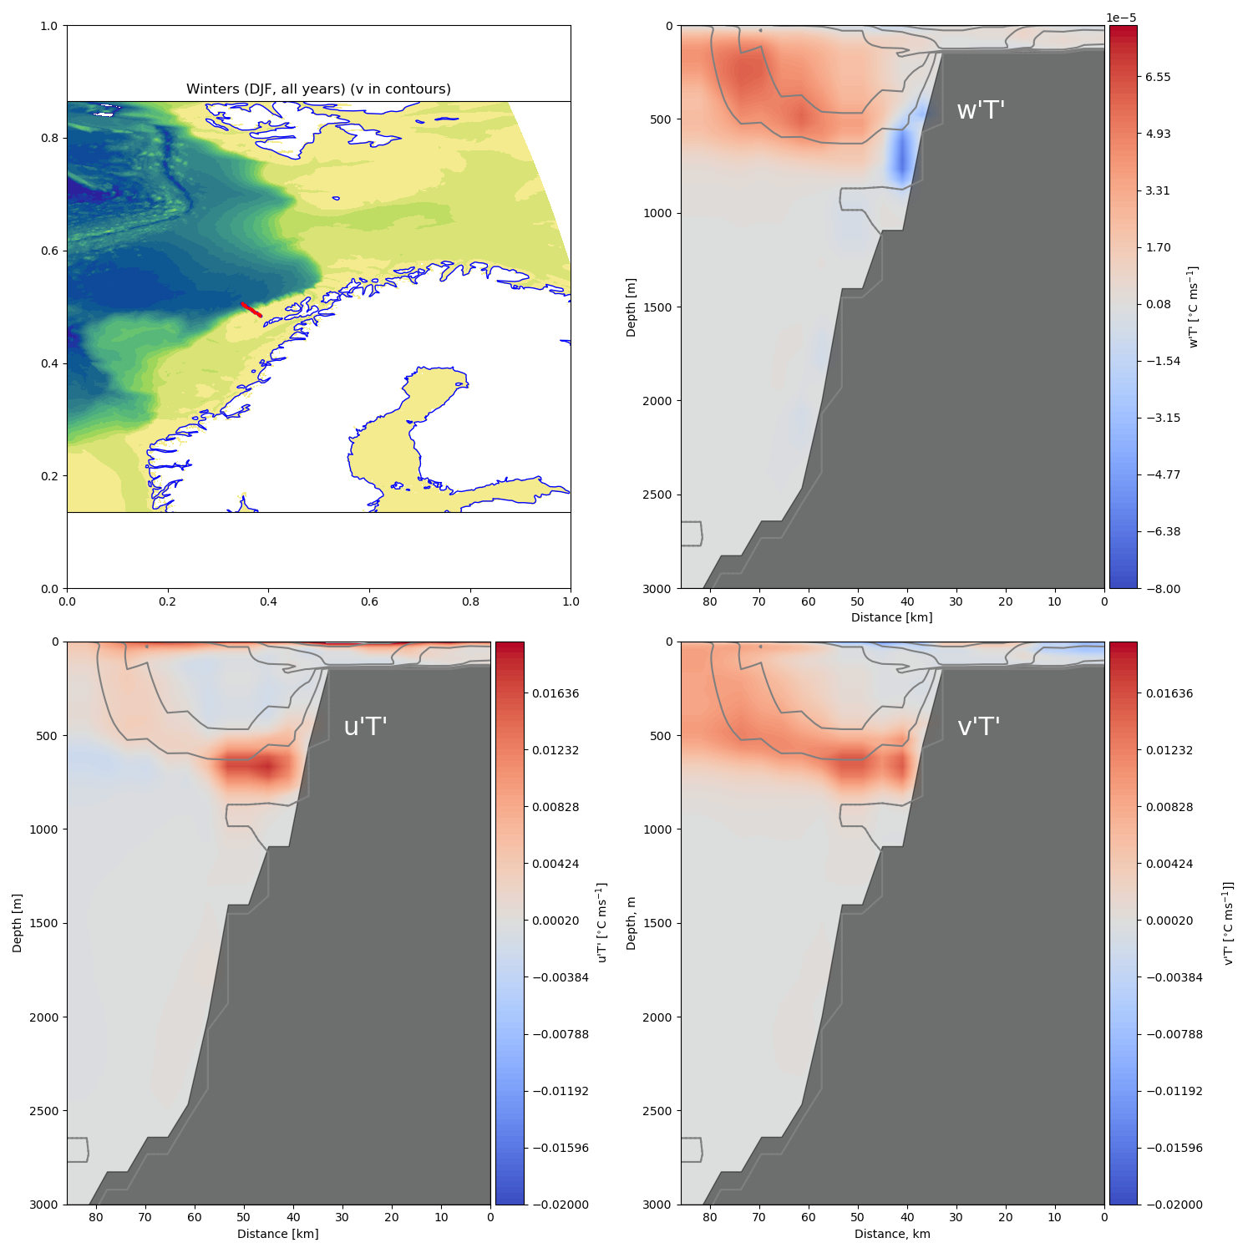
Seasonality of eddy fluxes on the Nordic Sea continental slope
Winter
Summer
ICON
EERIE
All control years
Notes:
Till Baumann

Slide 10
What next
What about salinity fluxes?
Why are eddy temperature fluxes so much stronger in the Labrador Sea/Subpolar gyre in ICON than in FESOM?
Vertical eddy fluxes across the mixed layer base (almost there, Ruirui, Ingo)
With thanks to: Andrea, Ingo, Nathan, Ruirui, Till, Boris, Emma.

